Slide 1
Is anyone out there?
By: Alejandro Ortega
Period 4

Slide 2
Curiosity
No one knows if there is life out there
There have been some evidence that they might have existed
There is also evidence the came to earth
Crop circles are some the evidences that aliens have visited us

Slide 3
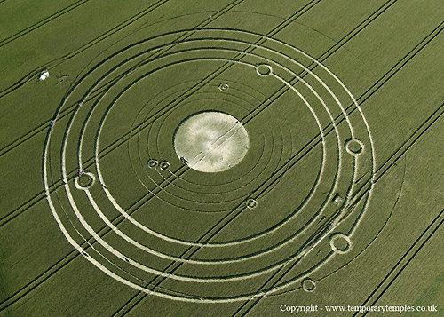
Crop Circle

Slide 4
Ancient Life in Nearby Planets
There has been evidence that the Earth wasn’t the only planet that had life in the early stages
Mars has signs of bodies of water that used to flow through the planet
Venus also had signs of bodies of water throughout the planet

Slide 5
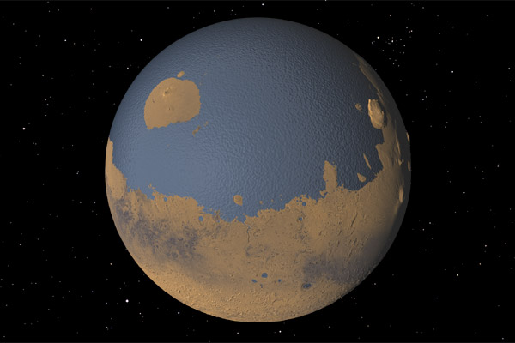
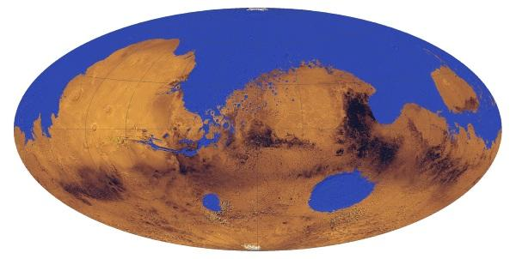
planets

Slide 6
Ways of communication
Radios
Sattelites
Cell phones

Slide 7
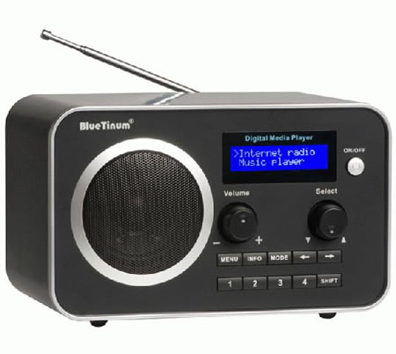
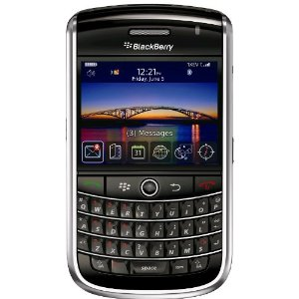
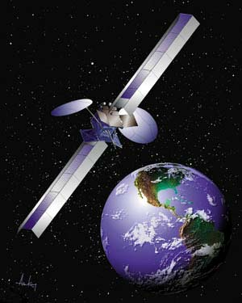
pictures

Slide 8
aliens
I picture the aliens green big eyes and small

